Slide 1


Rahul Gopal
2022-11-15

Slide 2

Outline
Executive Summary
Introduction
Methodology
Results
Conclusion
Appendix

Slide 3
Executive Summary
Summary of methodologies
Summary of all results

Slide 4
Introduction
Project background and context
Problems you want to find answers

Slide 5

Section 1

Slide 6
Methodology
Executive Summary
Data collection methodology:
Falcon 9 launch details were extracted from Wikipedia.
Perform data wrangling
Filtered the data using the Boot Version column to only keep the Falcon 9 launches
Perform exploratory data analysis (EDA) using visualization and SQL
Perform interactive visual analytics using Folium and Plotly Dash
Perform predictive analysis using classification models
How to build, tune, evaluate classification models

Slide 7
Data Collection – SpaceX API
Request API and parse the SpaceX launch Data
Data can be collected from SpaceX API.
SpaceX-API is a open-source REST API for rocket, core, capsule, pad and launch data.
The flowchart for the data collection is shown in figure 1.
GitHub - Link
Filter the data
Normalization of Data
Figure 1:Flow chart of data collection

Slide 8
Data Collection - Scraping
Request the Falcon9 launch webpage
Web scraping is the process of using bots to extract the content and data from website.
Web scraping extracts the underlying HTML code and stores in a database.
The flowchart for the data collection is shown in figure 1.
GitHub link
Extract all the column/variable name from the HTML table header
Appending data to keys and dataframe to .csv
Figure 1:Flow chart of data collection

Slide 9
Data Wrangling
Check Null values
Calculate the number of launch on each site
Calculate number of orbit
Calculate the no. of occurrence and mission outcome per orbit type
Create a landing outcome column
Handle null values

Slide 10
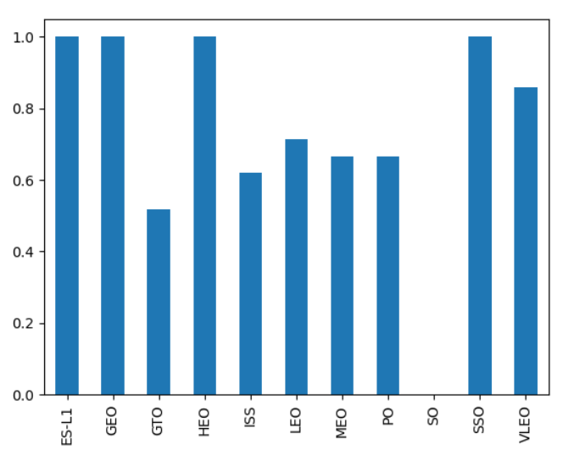
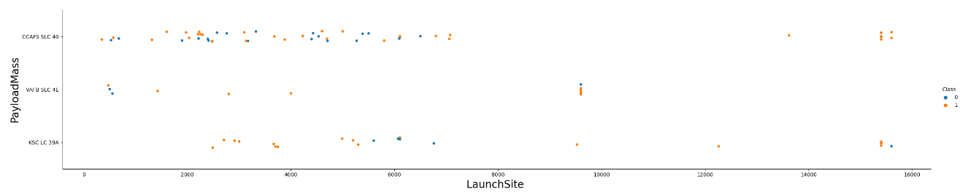
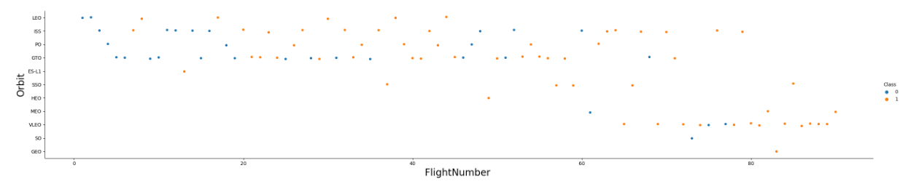
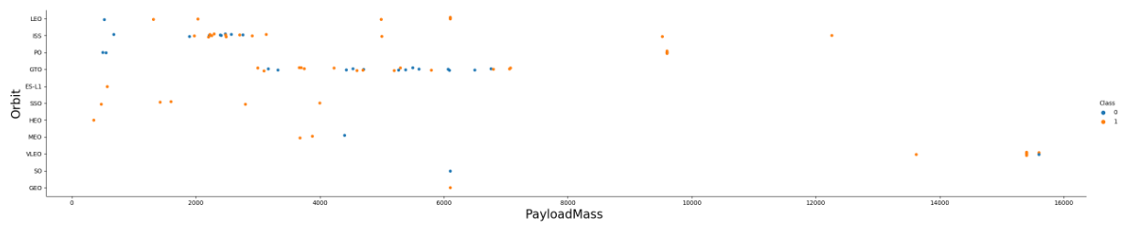
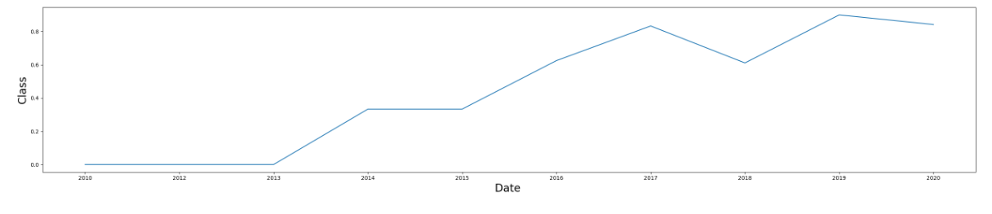
EDA with Data Visualization
https://github.com/Rahul-Gopal/IBM-Data-Science-Final-Project/blob/f13aaa2a168eb31458e402636760876d7a85d7b0/jupyter-labs-eda-dataviz.ipynb.jupyterlite.ipynb

Slide 11
EDA with SQL
Following query were performed
Display the names of the unique launch sites in the space mission
Display the total payload mass carried by boosters launched by NASA (CRS)
Display average payload mass carried by booster version F9 v1.1
List the date when the first succesful landing outcome in ground pad was acheived.
List the names of the boosters which have success in drone ship and have payload mass greater than 4000 but less than 6000
List the total number of successful and failure mission outcomes
List the names of the booster_versions which have carried the maximum payload mass. Use a subquery
List the records which will display the month names, failure landing_outcomes in drone ship ,booster versions, launch_site for the months in year 2015.
Rank the count of successful landing_outcomes between the date 04-06-2010 and 20-03-2017 in descending order.
https://github.com/Rahul-Gopal/IBM-Data-Science-Final-Project/blob/f13aaa2a168eb31458e402636760876d7a85d7b0/EDA-SQL.ipynb

Slide 12
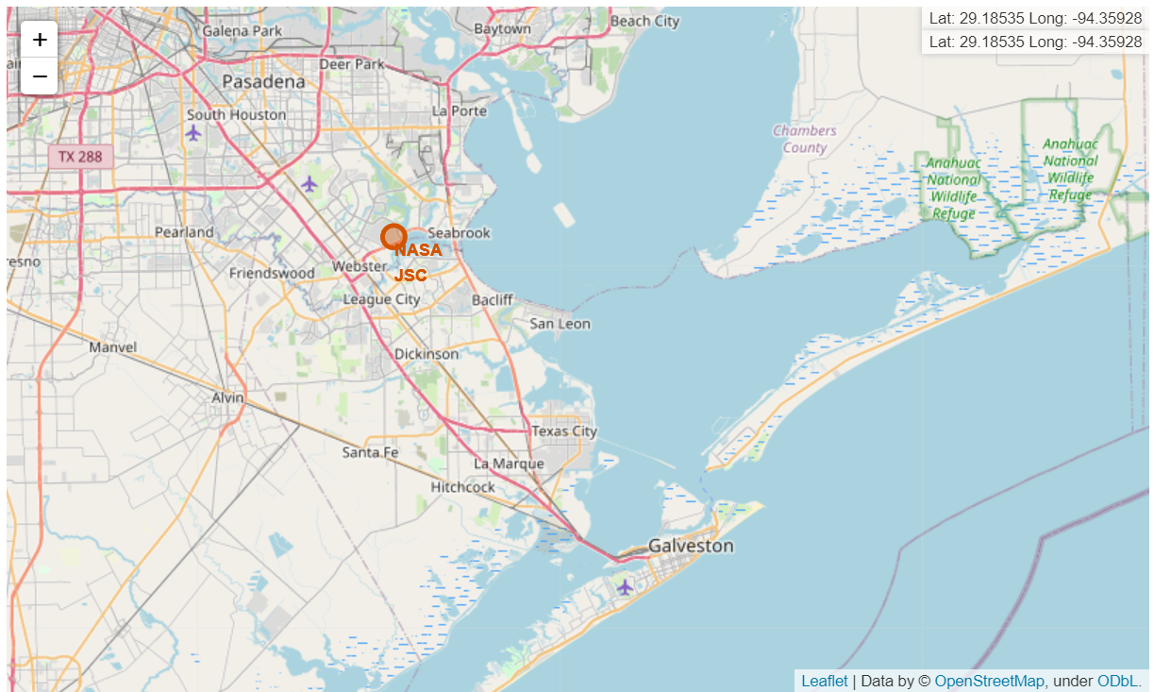
Build an Interactive Map with Folium

Slide 13
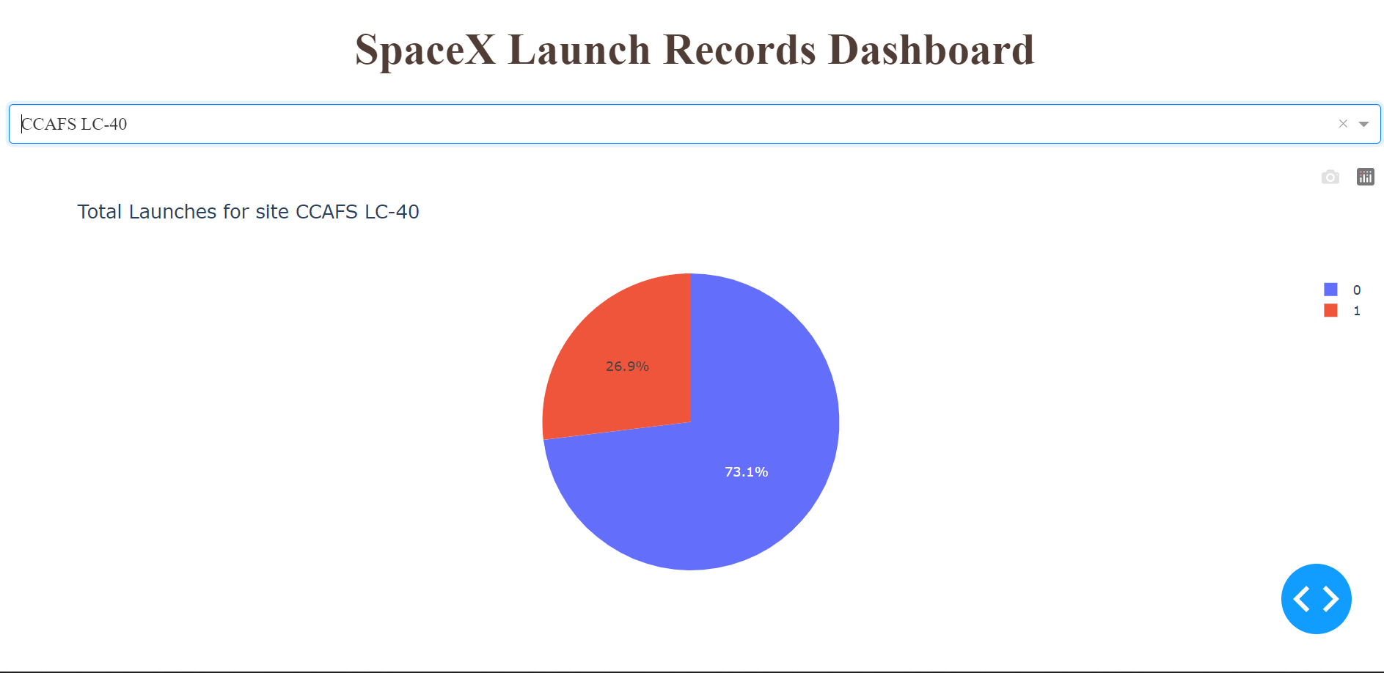
Build a Dashboard with Plotly Dash
Summarize what plots/graphs and interactions you have added to a dashboard
Explain why you added those plots and interactions
Add the GitHub URL of your completed Plotly Dash lab, as an external reference and peer-review purpose

Slide 14
Predictive Analysis (Classification)
Logistic regression , support vector machine, decision tree and k nearest neighbors were performed on the dataset and results were compared.
Data preparation
Performing Classification
Comparison of result

Slide 15

Section 2

Slide 16
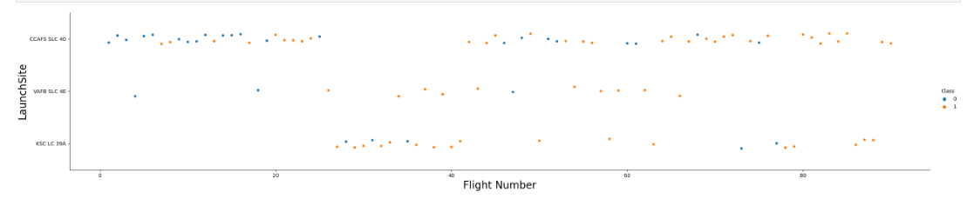
Flight Number vs. Launch Site
Show a scatter plot of Flight Number vs. Launch Site

Slide 17
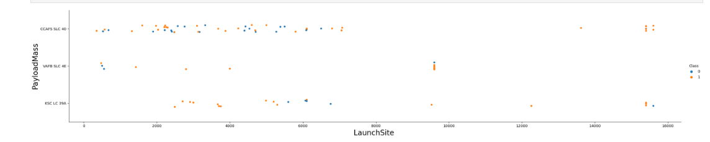
Payload vs. Launch Site
Show a scatter plot of Payload vs. Launch Site

Slide 18
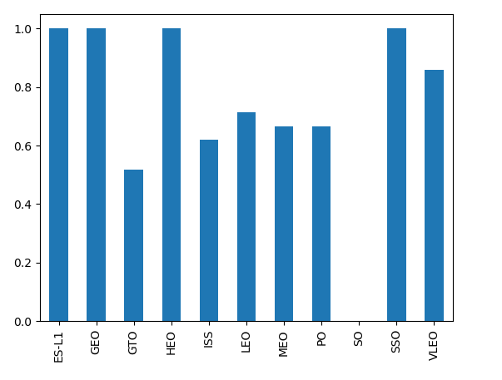
Success Rate vs. Orbit Type
Show a bar chart for the success rate of each orbit type

Slide 19
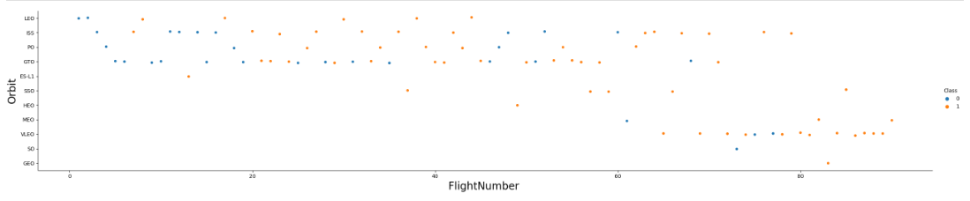
Flight Number vs. Orbit Type
Show a scatter point of Flight number vs. Orbit type

Slide 20
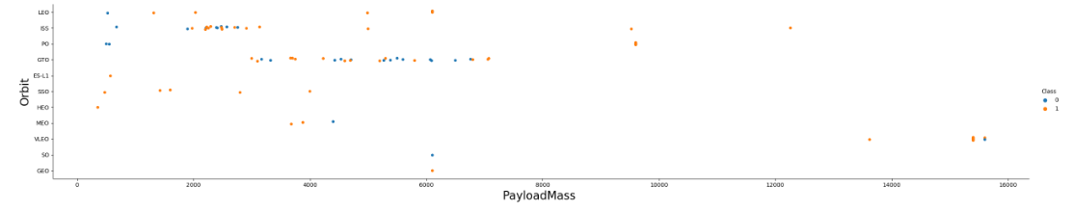
Payload vs. Orbit Type
Show a scatter point of payload vs. orbit type

Slide 21
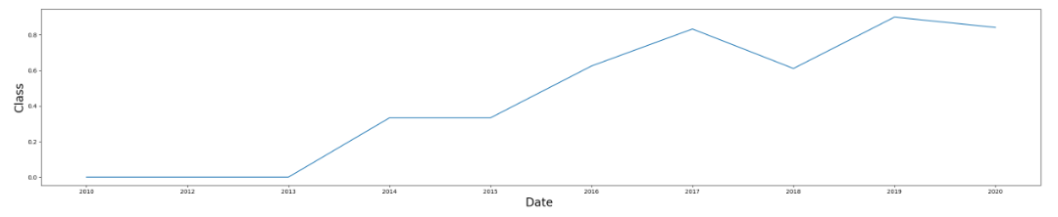
Launch Success Yearly Trend
Show a line chart of yearly average success rate

Slide 22
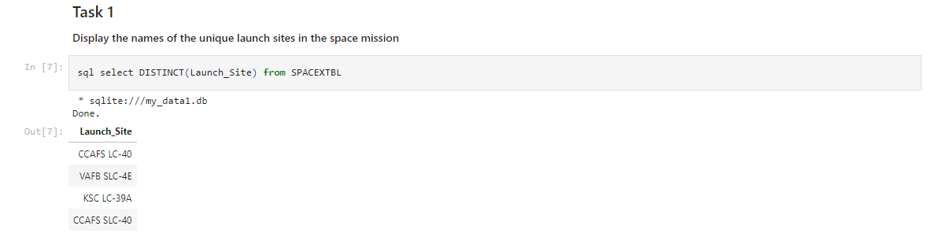
All Launch Site Names
Find the names of the unique launch site

Slide 23
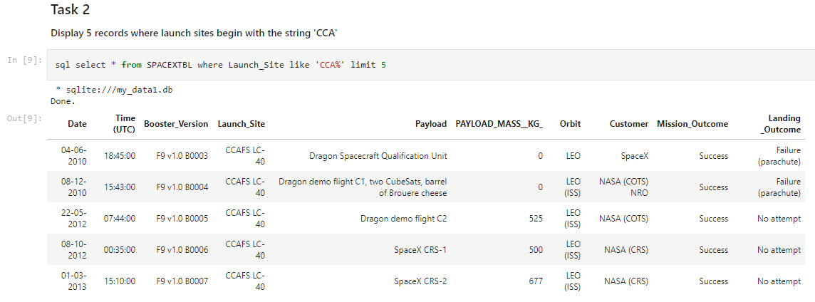
Launch Site Names Begin with 'CCA'
Find 5 records where launch sites begin with `CCA`

Slide 24
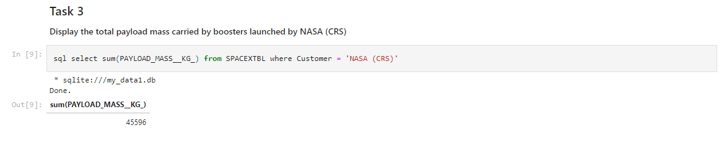
Total Payload Mass
Calculate the total payload carried by boosters from NASA

Slide 25
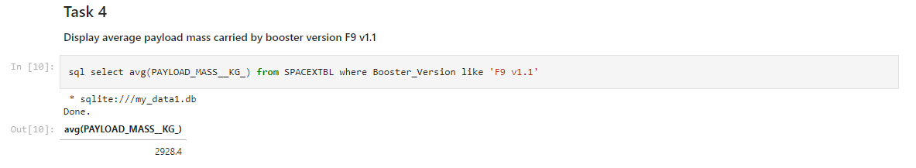
Average Payload Mass by F9 v1.1
Calculate the average payload mass carried by booster version F9 v1.

Slide 26
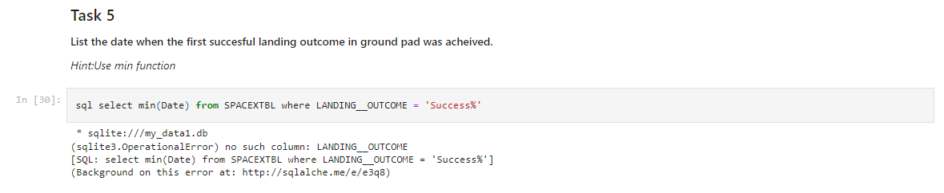
First Successful Ground Landing Date
Find the dates of the first successful landing outcome on ground pad

Slide 27
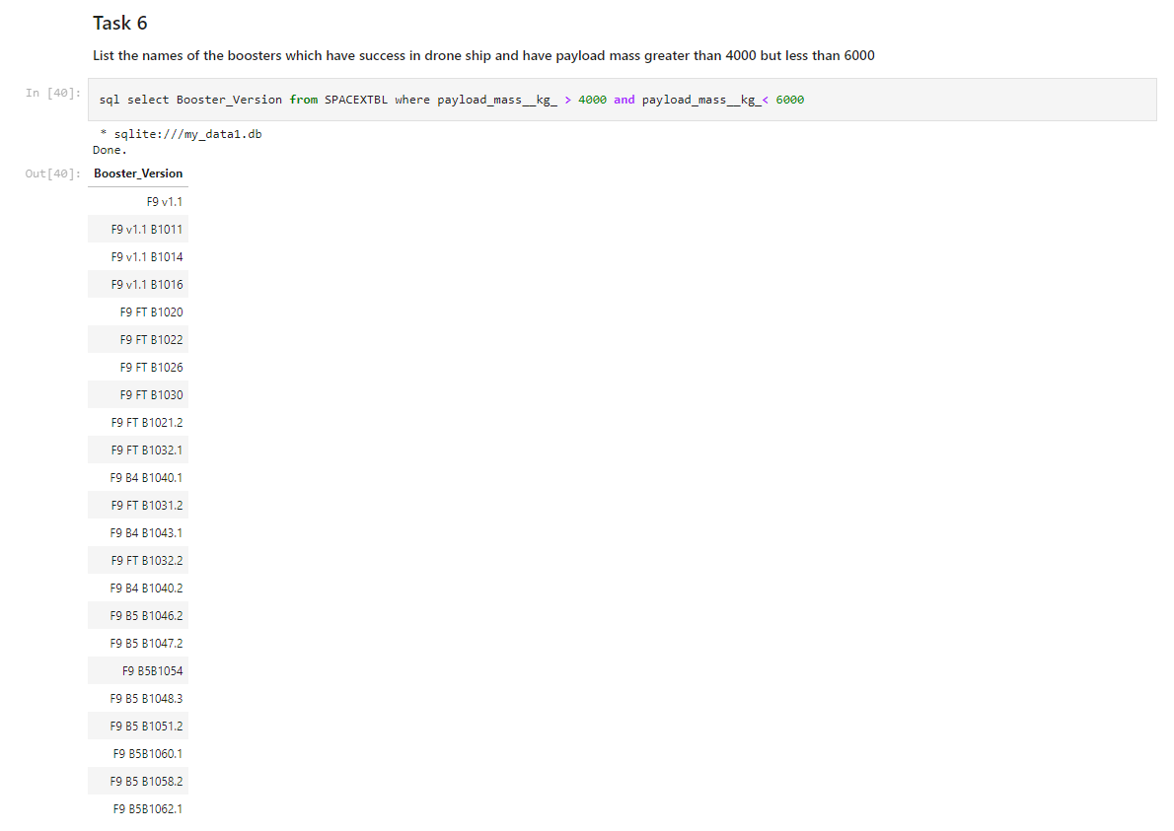
Successful Drone Ship Landing with Payload between 4000 and 6000
List the names of boosters which have successfully landed on drone ship and had payload mass greater than 4000 but less than 6000

Slide 28
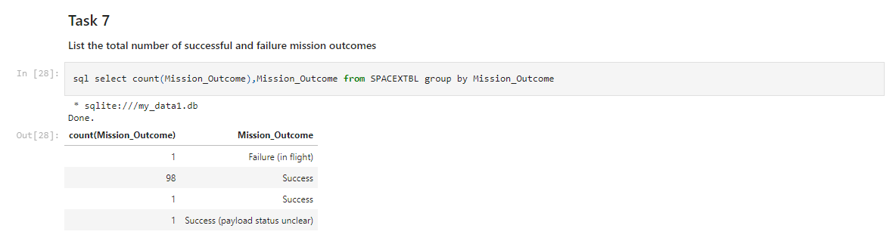
Total Number of Successful and Failure Mission Outcomes
Calculate the total number of successful and failure mission outcomes

Slide 29
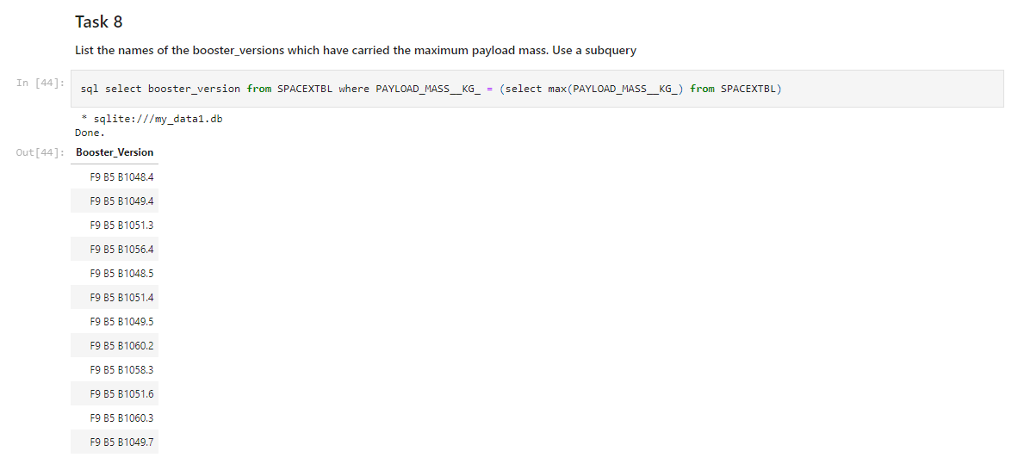
Boosters Carried Maximum Payload
List the names of the booster which have carried the maximum payload mass

Slide 30
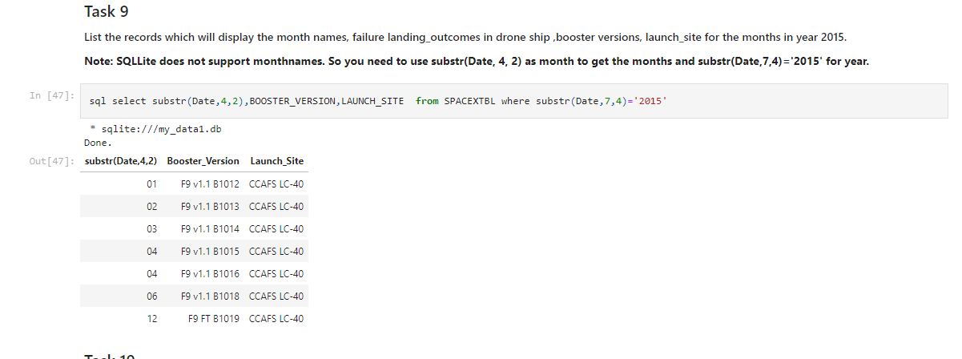
2015 Launch Records
List the failed landing_outcomes in drone ship, their booster versions, and launch site names for in year 2015

Slide 31
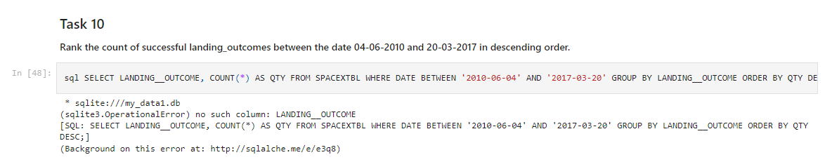
Rank Landing Outcomes Between 2010-06-04 and 2017-03-20
Rank the count of landing outcomes (such as Failure (drone ship) or Success (ground pad)) between the date 2010-06-04 and 2017-03-20, in descending order

Slide 32

Section 3

Slide 33
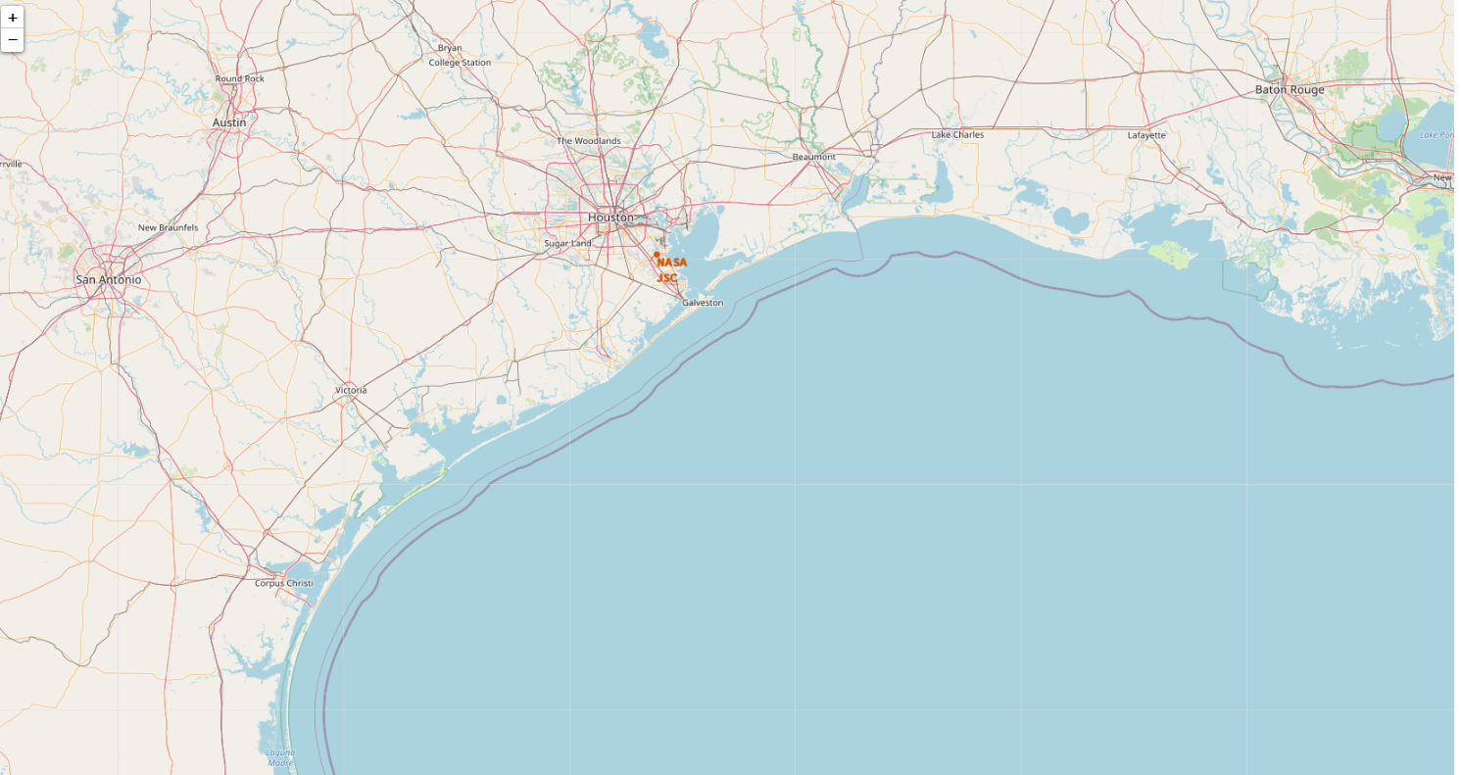
Sites on map

Slide 34
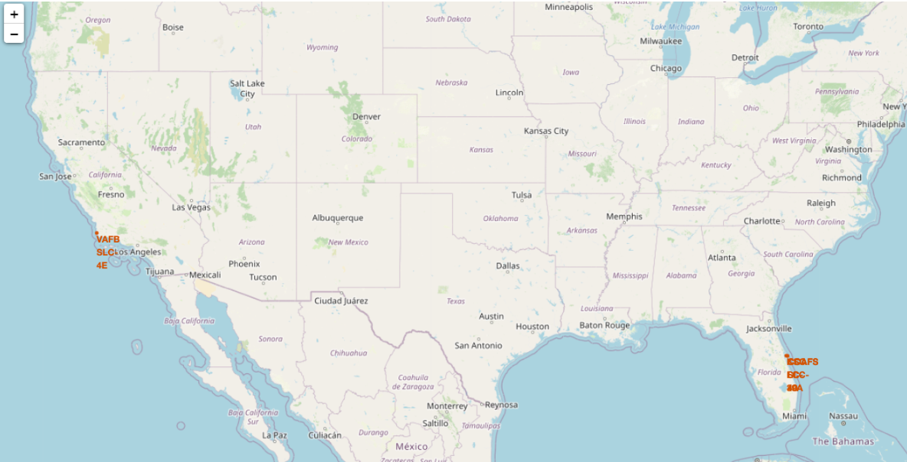
Success and failed launches

Slide 35
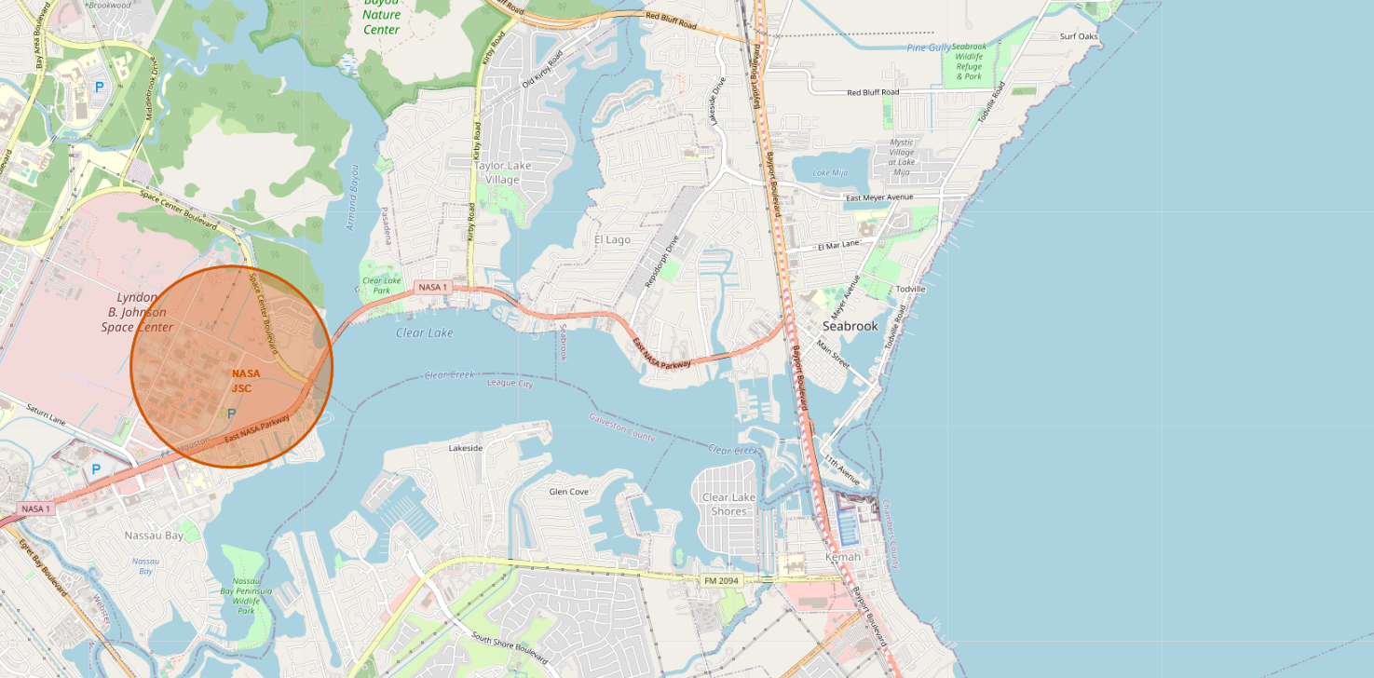
Marker with distance to a closest city

Slide 36

Section 4

Slide 37
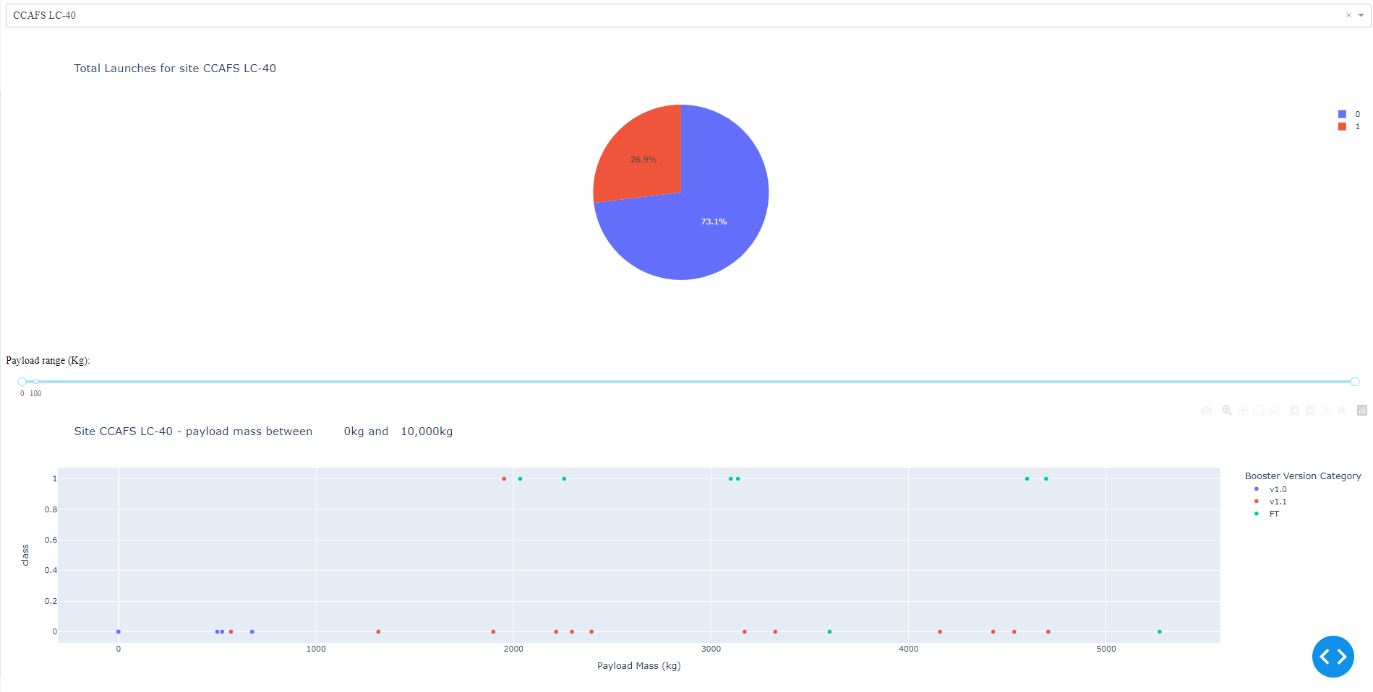
Dashboard for CCADS LC-40

Slide 38
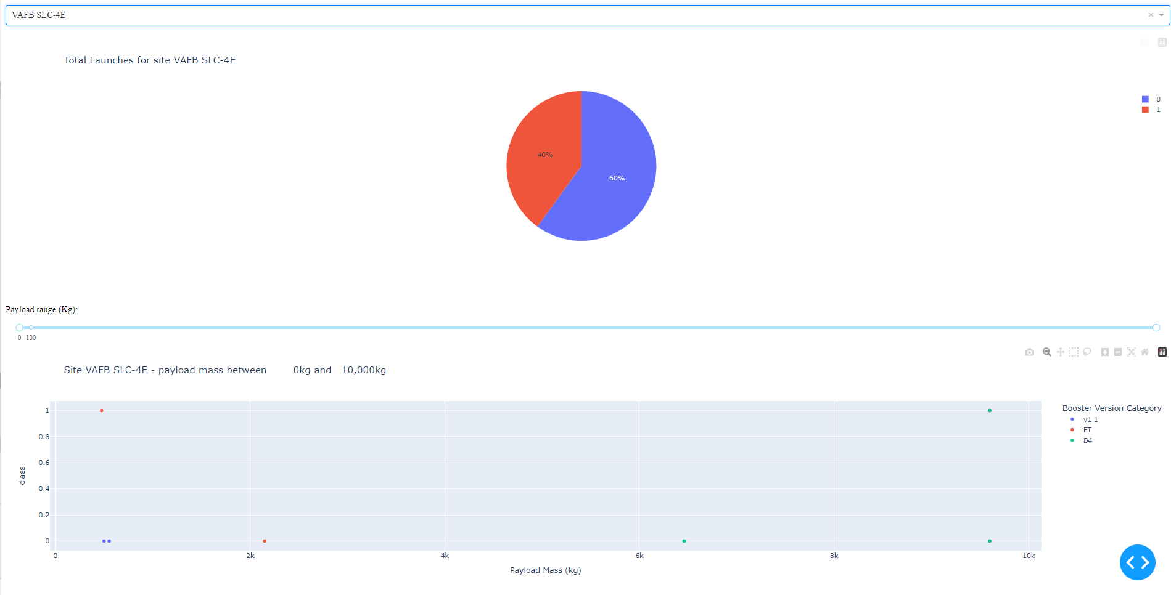
Dashboard for VAFB SLC-4E
Replace <Dashboard screenshot 2> title with an appropriate title
Show the screenshot of the piechart for the launch site with highest launch success ratio
Explain the important elements and findings on the screenshot

Slide 39
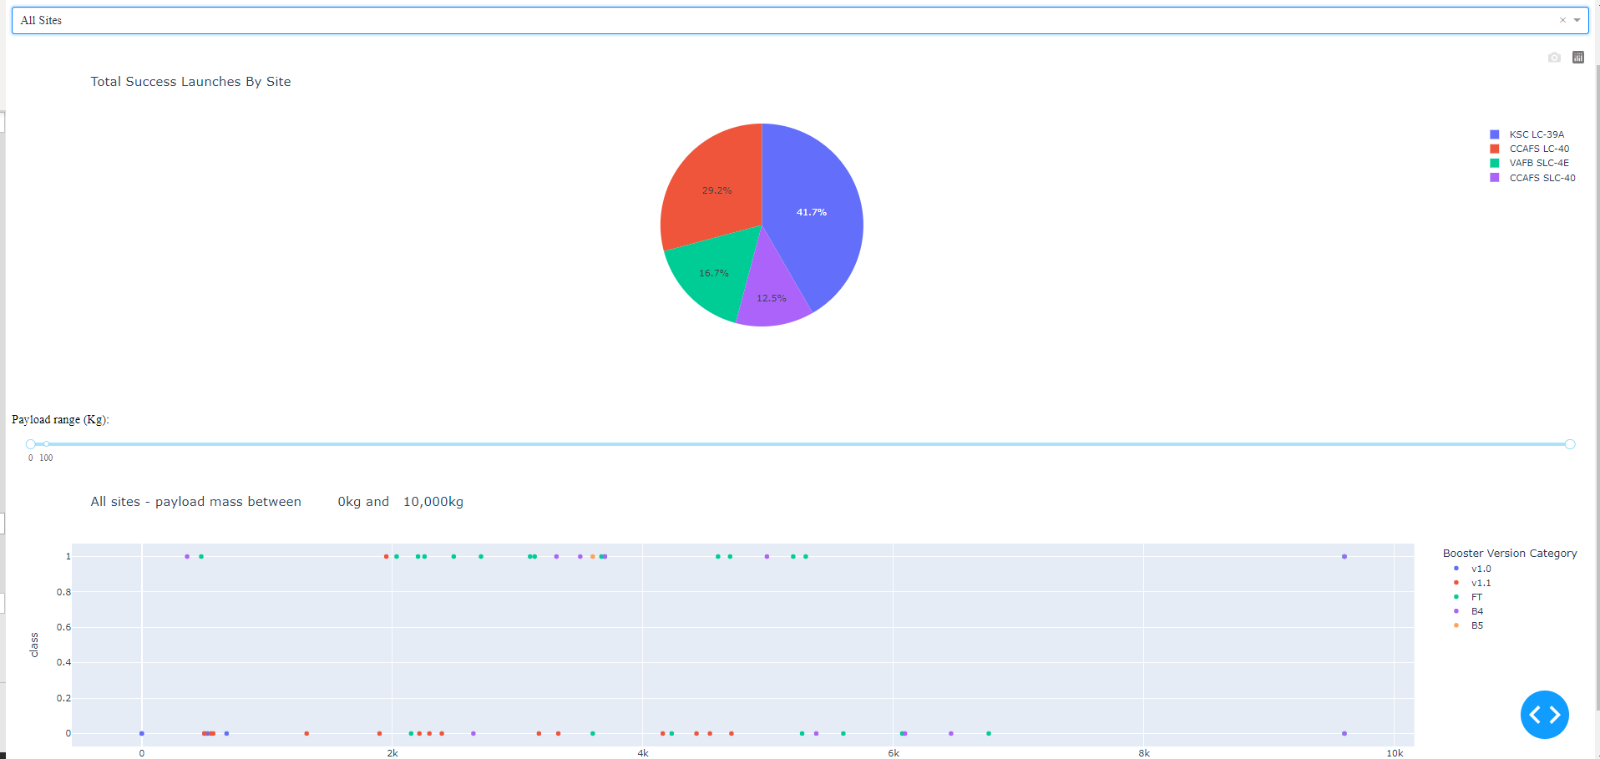
Dashboard for all site
Replace <Dashboard screenshot 3> title with an appropriate title
Show screenshots of Payload vs. Launch Outcome scatter plot for all sites, with different payload selected in the range slider
Explain the important elements and findings on the screenshot, such as which payload range or booster version have the largest success rate, etc.

Slide 40

Section 5

Slide 41
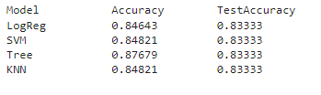
Classification Accuracy
Visualize the built model accuracy for all built classification models, in a bar chart

Slide 42
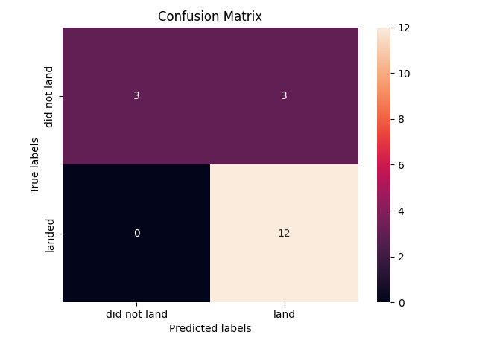
Confusion Matrix
Show the confusion matrix of the best performing model with an explanation

Slide 43
Conclusions
SVM,KNN and Logistic Regression models are best in term of prediction accuraccy of dataset
KSC LC 39A has the most successful launches from all the sites
Orbit GEO HEO SSO ES has best success rate

Slide 44


